Slide 1
Syphilis 101
WCHC Talking Series
Ameeta Singh, BMBS, MSc, FRCPC
Infectious Diseases, Department of Medicine, University of Alberta
June 18, 2025
WARNING: GRAPHIC CLINICAL IMAGES

Slide 2
Objectives
To provide a brief overview of syphilis, common signs and symptoms, key stats and current state, how it affects pregnant women living with HIV, and the chances of co-infection if the mother has active syphilis.

Slide 3



Syphilis has been around forever…Famous syphilitics
Ludwig van
Beethoven
Genius to madness: Famous (probable) syphilitics
James Joyce, Idi Amin,
Al Capone and Lenin.
Christopher Columbus

Slide 4
Important events in the history of syphilis
First recorded outbreak of syphilis in Europe
First serological test for syphilis by Wasserman, Neisser and Bruck
Global syphilis rates rising; in Alberta highest since 1948
1905
1943
Schaudinn and Hoffman discover Treponema pallidum
Mahoney and colleagues successfully treat 4 patients with syphilis with penicillin
1495
1906
2020

Slide 5
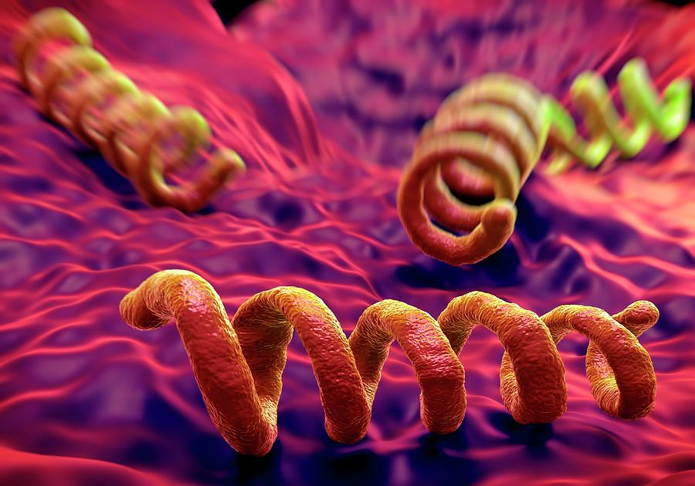
WHAT CAUSES SYPHILIS?
Caused by a bacterium: Treponema pallidum
https://sciencephotogallery.com/featured/treponema-pallidum-syphilis-bacterium-science-artwork.html

Slide 6
Syphilis – how is it spread?
Through intimate/sexual contact (oral/vaginal/anal)
From pregnant woman to child during pregnancy

Slide 7
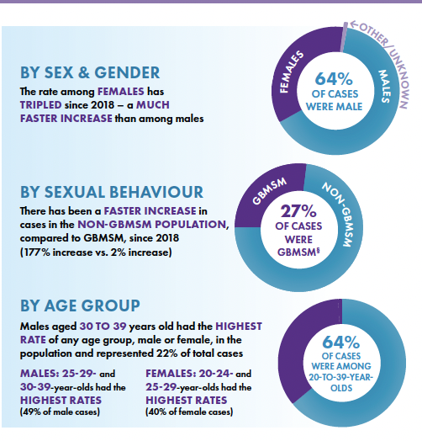
Who is impacted by syphilis in Canada?
https://www.canada.ca/en/public-health/services/reports-publications/canada-communicable-disease-report-ccdr/monthly-issue/2025-51/issue-2-3-february-march-2025/infectious-congenital-syphilis-2023.html

Slide 8
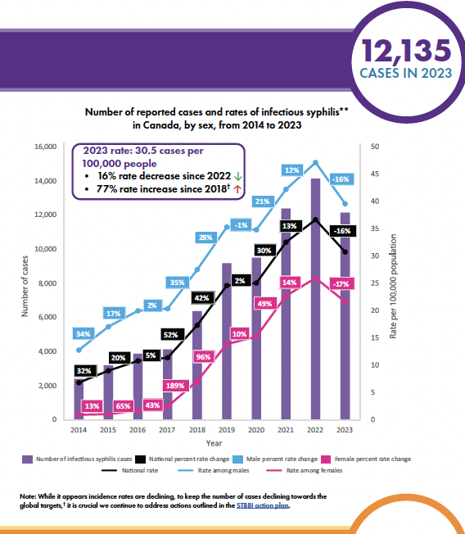
Who is impacted by syphilis in Canada?
https://www.canada.ca/en/public-health/services/reports-publications/canada-communicable-disease-report-ccdr/monthly-issue/2025-51/issue-2-3-february-march-2025/infectious-congenital-syphilis-2023.html

Slide 9
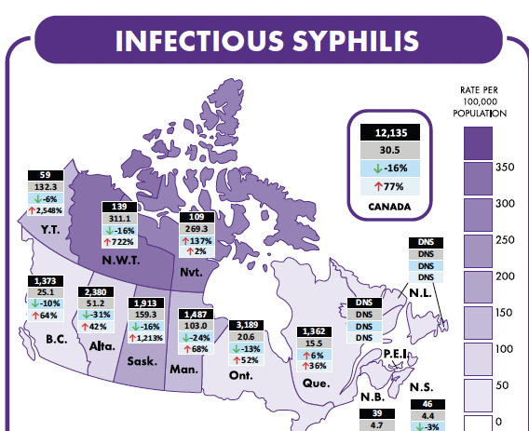
Syphilis in Canada varies depending on which part of the country you are in
https://www.canada.ca/en/public-health/services/reports-publications/canada-communicable-disease-report-ccdr/monthly-issue/2025-51/issue-2-3-february-march-2025/infectious-congenital-syphilis-2023.html

Slide 10
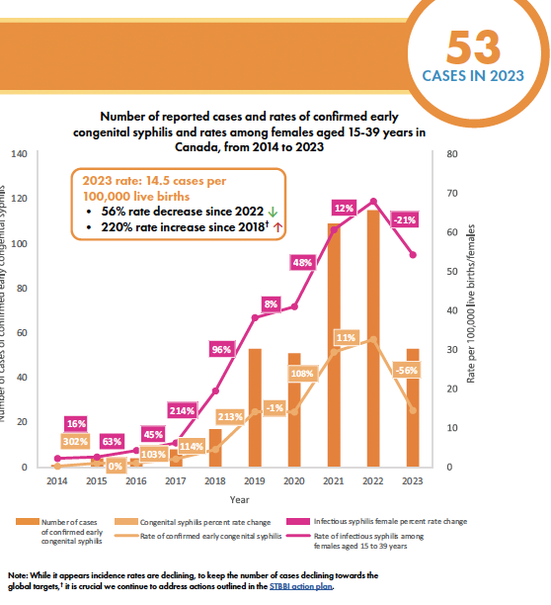
Congenital syphilis cases in Canada
CONGENITAL SYPHILIS = SYPHILIS IN CHILD BORN TO MOTHER WITH SYPHILIS
https://www.canada.ca/en/public-health/services/reports-publications/canada-communicable-disease-report-ccdr/monthly-issue/2025-51/issue-2-3-february-march-2025/infectious-congenital-syphilis-2023.html

Slide 11
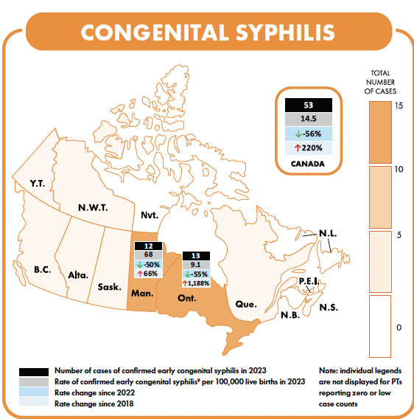
Congenital syphilis in Canada varies depending on which part of the country you are in
https://www.canada.ca/en/public-health/services/reports-publications/canada-communicable-disease-report-ccdr/monthly-issue/2025-51/issue-2-3-february-march-2025/infectious-congenital-syphilis-2023.html

Slide 12
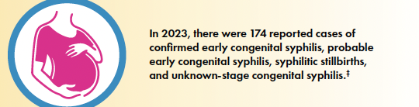
What is happening with congenital syphilis (CS) in Canada?
https://www.canada.ca/en/public-health/services/reports-publications/canada-communicable-disease-report-ccdr/monthly-issue/2025-51/issue-2-3-february-march-2025/infectious-congenital-syphilis-2023.html
The expected number of CS cases in Canada today = ZERO since all pregnant women
who access care are tested and treated if needed for syphilis

Slide 13
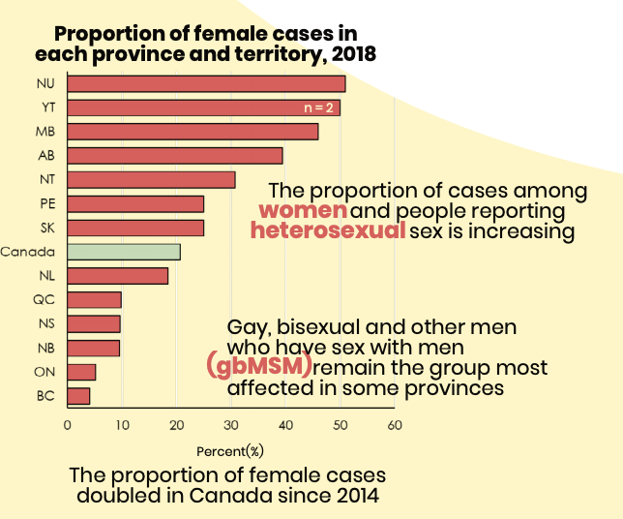
Significant geographic variation in infectious syphilis among gbMSM in Canada
https://www.canada.ca/content/dam/phac-aspc/documents/services/reports-publications/canada-communicable-disease-report-ccdr/monthly-issue/2019-45/issue-11-november-7-2019/ccdrv45i11-eng.pdf

Slide 14
Possible explanations for the rise in infectious syphilis among gay & bisexual men who have sex with men (gBMSM)
U=U [HIV infected persons with an undetectable viral load cannot transmit to others] (Rodger, Jama 2016)
HIV pre-exposure prophylaxis (PrEP) (Grant, NEJM, 2010)
The availability of mobile dating apps which make it easier to arrange sexual partners (Tsai, Arch Sex Behav, 2019; Wang BMC Public Health, 2018)
Resultant increase in the number of sex partners, condomless sex, and the resurgence of STIs, including syphilis (Traeger, JAMA, 2019).

Slide 15
What about the rise in heterosexual persons?

Slide 16
Congenital syphilis: just the tip of the iceberg
UNSTABLE HOUSING
ACCESS TO AND USE OF PRENATAL CARE
INADEQUATE OR NONE
MENTAL HEALTH ISSUES
GEOGRAPHY
SOCIOECONOMIC STATUS
RURAL AND REMOTE RESIDENCE
PRAIRIE PROVINCES.
LOWER INCOME.
STIGMA
SUBSTANCE USE
HISTORICAL TRAUMA
DISCRIMINATION IN HEALTH CARE
ALCOHOL, TOBACCO, METHAPHETAMINES.
https://www.canada.ca/content/dam/phac-aspc/documents/services/reports-publications/canada-communicable-disease-report-ccdr/monthly-issue/2020-46/issue-10-oct-1-2020/ccdrv46i10a09b-eng.pdf
Notes:
© Copyright PresentationGO.com – The free PowerPoint and Google Slides template library

Slide 17
Intersection between drug use and syphilis
Drug use especially meth associated with multiple or concurrent sexual patners, inconsistent condom use and exchanging sex for drugs or money
Syphilis
Stimulant drugs (meth, cocaine)
Kidd, 2019
CDC, 2006
Zule, 2007
Flom, 2001
A significant proportion of syphilis cases occurring in
heterosexual persons is due to engaging in illicit drug use
Notes:
© Copyright PresentationGO.com – The free PowerPoint and Google Slides template library

Slide 18
Methamphetamines:
  Decreases inhibition
  Increases sexual arousal
  Impairs judgement
OPIOIDS DON’T PER SE INCREASE THE RISK FOR SYPHILIS BUT THE ADDICTION OFTEN
DRIVES PEOPLE TO ENGAGE IN BEHAVIOURS THAT PUT THEM AT RISK FOR SYPHILIS

Slide 19
Why do we care about syphilis?
For the person who is infected:
Can get sores on the genitals (30% do not)
If not treated, can go on to get rash, swollen lymph glands
Can also cause strokes, loss of vision, etc
Later in life, can develop memory changes and/or trouble walking

Slide 20
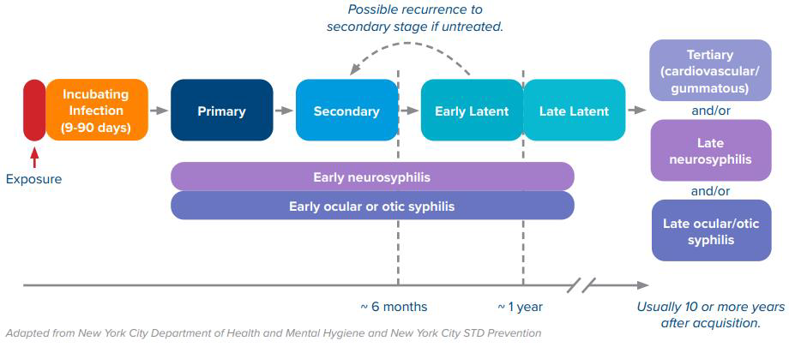
Syphilis - Stages
Notes:
Spirochete penetrates intact mucous membrane or microabrasions of skin and replicates, resulting in the formation 21 days later of a local, indurated, firm, painless ulcer known as chancre. The chancre is highly infectious. A few weeks to months later the chancre will resolve, even without treatment.
During the initial few months the treponeme disseminates hematogenously throughout the body. At around 8-12 weeks following initial infection, florid host immunologic response develops with florid clinical manifestations resulting. These typically include a disseminated rash, generalized lymphadenopathy, multiple skin lesions (chancres, mucous patches, condyloma lata (aka flat warts) develop. The skin lesions are teeming with spirochetes and are infectious. Other complications of this stage included meningitis, nephritis, hepatitis, ocular disease. After 2-6 weeks “in bloom” the skin lesions of secondary syphilis subside without treatment and the patient becomes asymptomatic despite persistent, indolent infection with spirochetes. This is the latent phase. After years of latency, various “tertiary” manifestations appear. Pathologically these represent smoldering, granulomtous inflammation around a few spirochetes. Clinically this manifests as skin lesions called “gummas”, aortic lesion called thoracic aneurysm (cardiovascular syphilis), neurologic lesions called neurosyphilis (General Paresis, Tabes dorsalis, meningovascular syphilis, ocular syphilis, meningitis).

Slide 21
Primary syphilis
30%: no lesions
May be multiple, painful
Co-infection (esp with herpes occurs)

Slide 22
Secondary syphilis
Rash, lymphadenopathy, fever, malaise, alopecia, mucus lesions, headaches
Neurologic (including eye and ear involvement can occur during this stage)
Condyloma lata
Alopecia
Images copyright@Ameeta Singh/Edmonton STI clinic

Slide 23
Secondary syphilis: rash common but variable presentation
Rash classically involves palms/soles

Slide 24
15-40% of untreated patients develop tertiary syphilis
Courtesy of Sunil Srinivas, MD
Bangalore, India
NEJM 2013;369(12): e16
Neurosyphilis most common tertiary stage
- 44 year review of Alberta data: 251/254 tertiary cases were NS and 3 CV. 53% early NS (Landry, 2019)
Cardiovascular
Gumma

Slide 25

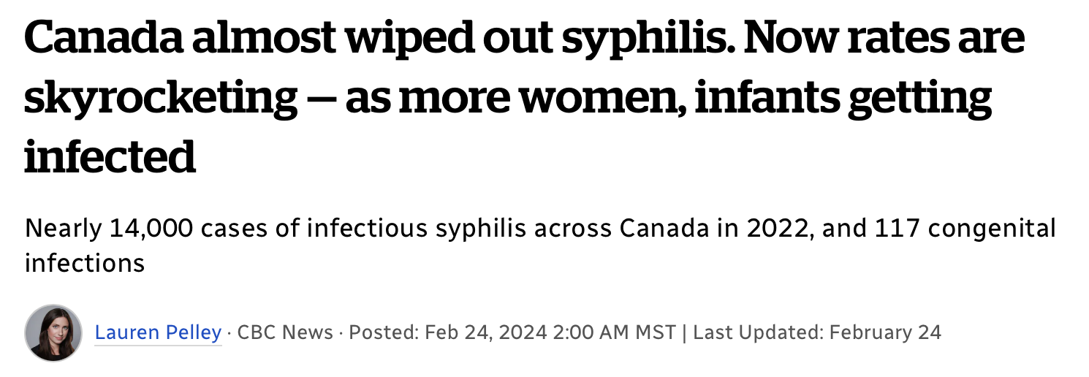
Syphilis in Pregnancy
Infected mother can pass to the baby during the pregnancy (congenital syphilis)
Baby can die (up to 20%)
If baby does not die, can be born with many problems of the organs (e.g. enlarged liver/spleen/rash, etc)

Slide 26
8 month old baby
Diagnosed with juvenile myelomonocytic leukemia at 3 months (hepato-splenomegaly, rash, anemia)
Treated with 10 days of iv penicillin

Slide 27
How do we diagnose syphilis?
Usually with a blood test (lab will then do 2-3 tests to confirm syphilis)
This usually means that the blood is collected then the person returns 7-10 days later if positive for treatment
Since syphilis and other sexually transmitted and blood borne infections go together, we usually do tests for HIV, gonorrhea and chlamydia at the same time

Slide 28
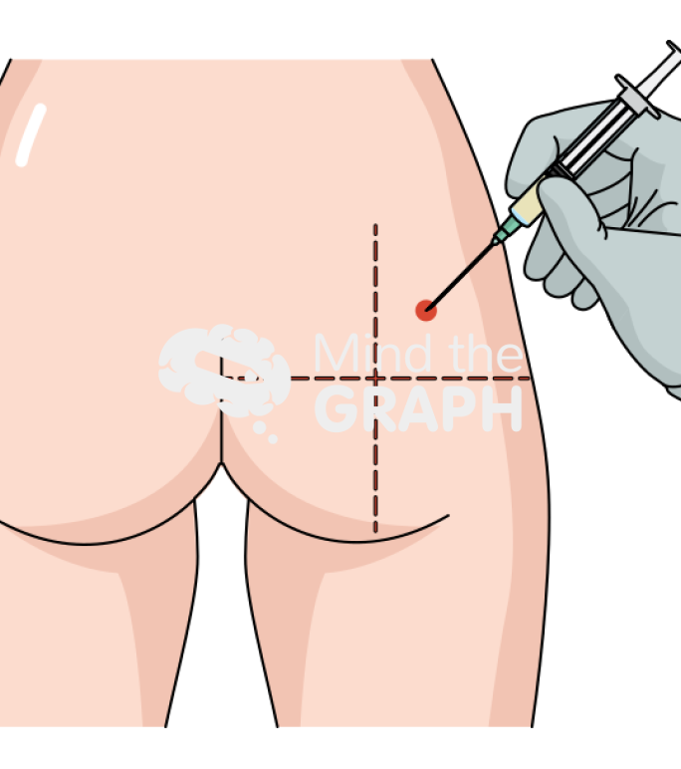
How do we treat syphilis?
Most people can be cured with a single injection of penicillin
Some will need 2- 3 injections a week apart
If they have neurological involvement will need IV antibiotics

Slide 29
Why are pregnant women not seeking health care and getting tested for syphilis during pregnancy?
Stigma and mistrust of the health system due to racism and discrimination
Lack of transport
Other priorities – housing needs, food, substance use, mental health
Fear that their babies may be taken away from them

Slide 30
Don’t forget to follow up HIV as well
STIs especially genital ulcer disease can increase the risk of transmission of HIV
Therefore anyone diagnosed with infectious syphilis should also be followed with serial HIV tests

Slide 31
Syphilis in HIV co-infected persons
Presentations of syphilis may be more severe or atypical
Likelihood of developing neurosyphilis also linked to CD4 < 350 cells/uL (3X increase)
HIV itself can cause pleocytosis
Ongoing controversy about need to identify asymptomatic neurosyphilis in HIV. Some recommend LP with CD4 < 350, RPR > 1:32 dils and no ARV.
Risk of NS and serological failures less likely in those who take antiretroviral therapy

